Slide 1
“Analyzing pyschological effects & benfits of playing video games”
By,
SAMIT DHAWAL
KUSHAL BELLANI
Date: 26-10-2021

Slide 2
Table of Contents
Introduction
Objective
Expected Outcome
Output Screen shots
The fields data available
Advantages of the tool
Disadvantages of the tool
Tools & Technology
Conclusion
References

Slide 3
Introduction
VGChartz is a network of five video game websites namely VGChartz, gamrFeed, gamrReview, gamrTV and gamrConnect.
VGChartz is a video game sales tracking website that provide weekly sales figures of console software and hardware by region.
This VGChartz site was launched in June 2005 and is owned by Brett Walton.

Slide 4
Objective
To analyze the pyschological benefits and effects of playing Video Games on the data taken from the scrap of vgchartz.com

Slide 5
Expected Outcome
So the major Outcome are:
Will be able to find which game reported highest Sales in Japan ever.
Will be able to find which games in North America soled over 5 million USD.
To find how much sale did ‘Grand Theft Auto: San Andreas’ report in the rest of the world.
Will be able o find which place did ‘Call of Duty: Ghosts’ gain maximum sales.
Will be able to find which genre of games is the most popular?
Will be able to find how many percent games does Electronic Arts Publish?

Slide 6
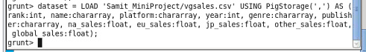
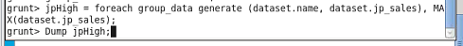
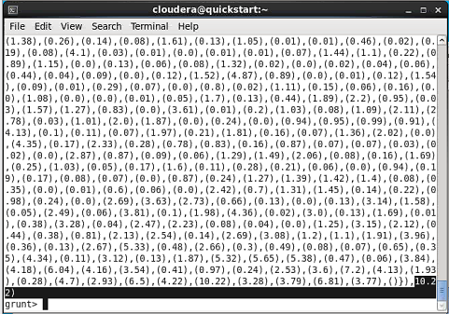
Output Screen Shots

Slide 8
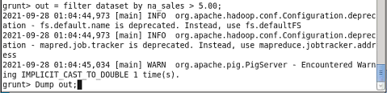
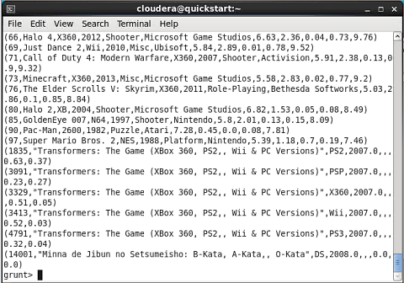

Slide 9
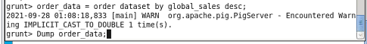
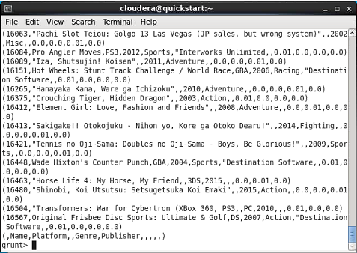

Slide 10
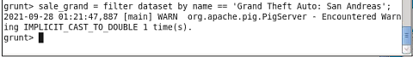
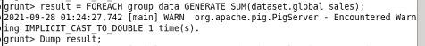
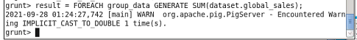
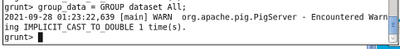
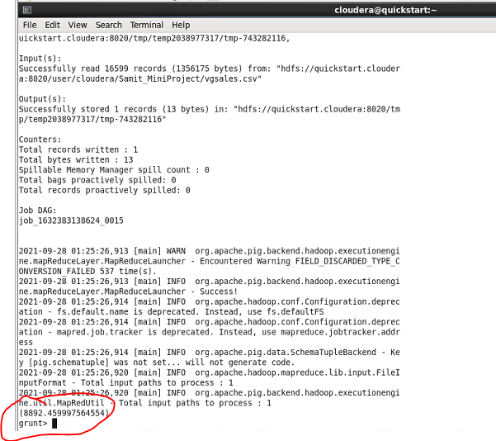

Slide 11
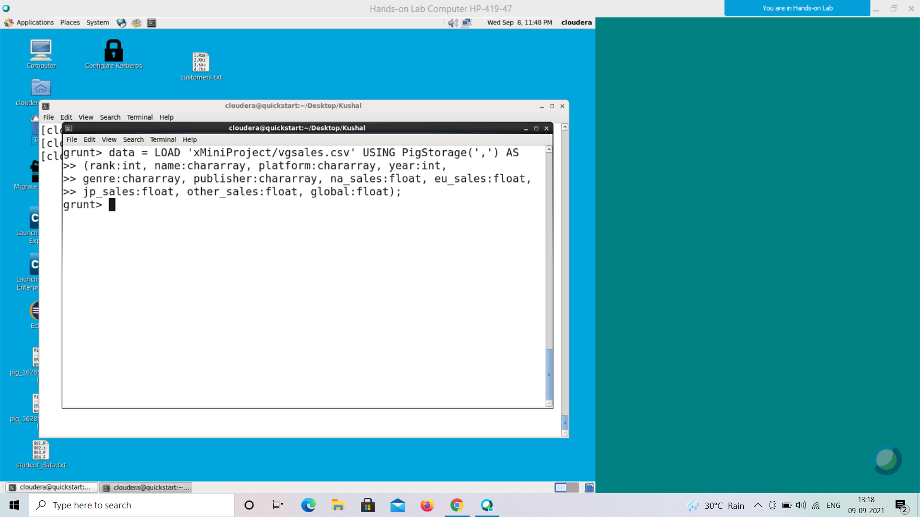
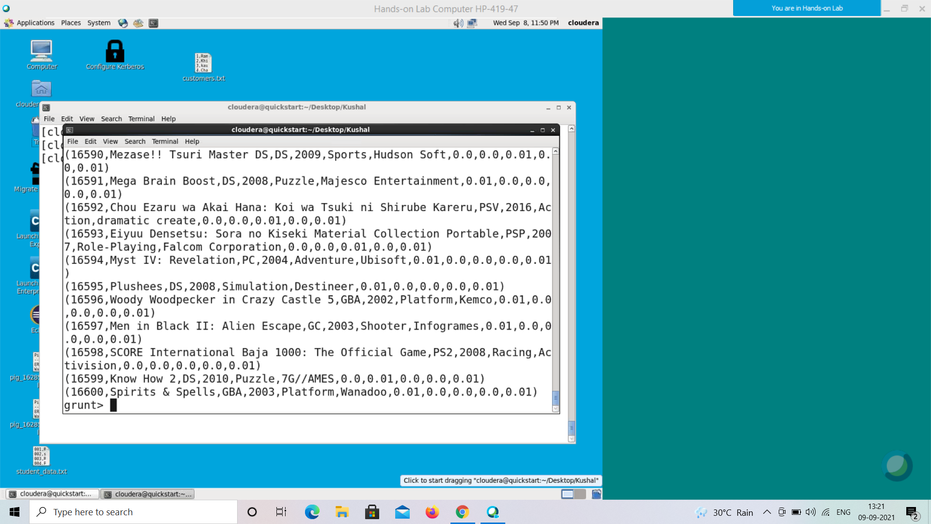

Slide 12
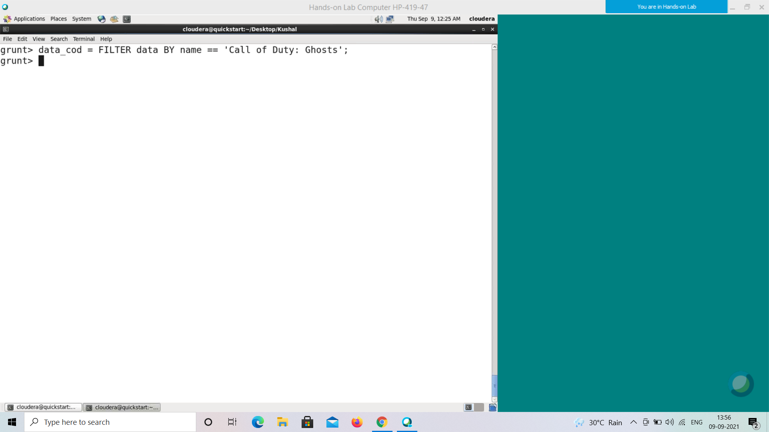
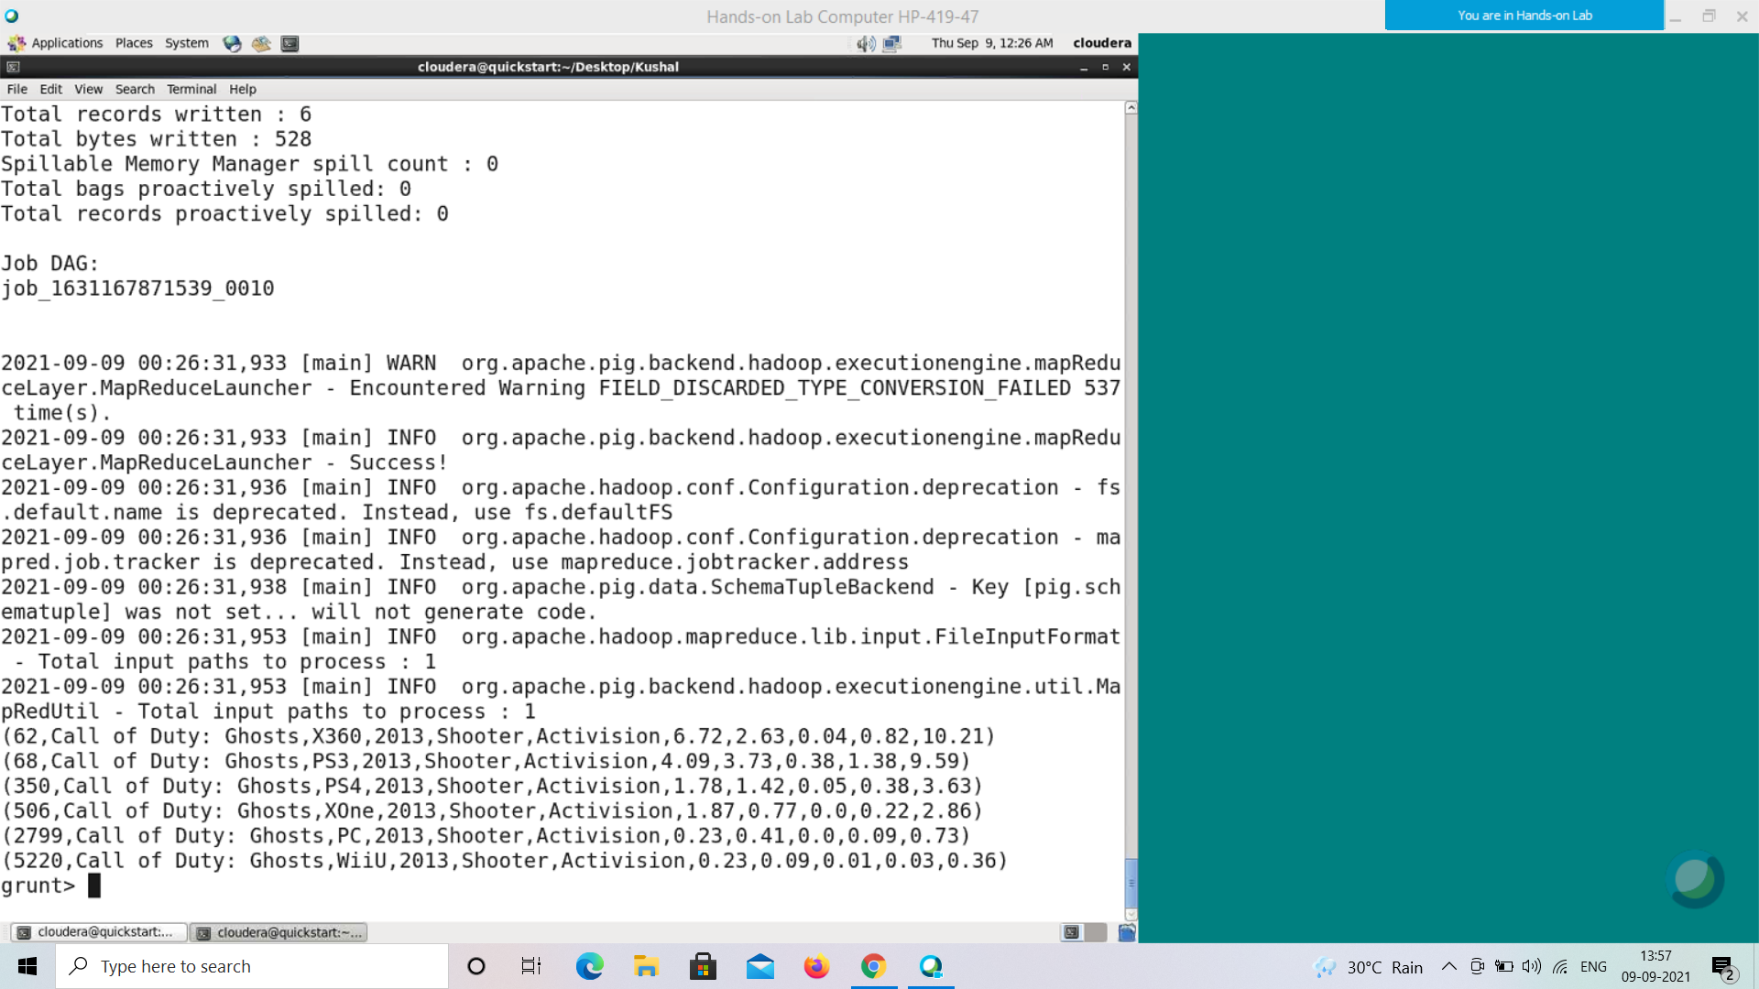

Slide 13
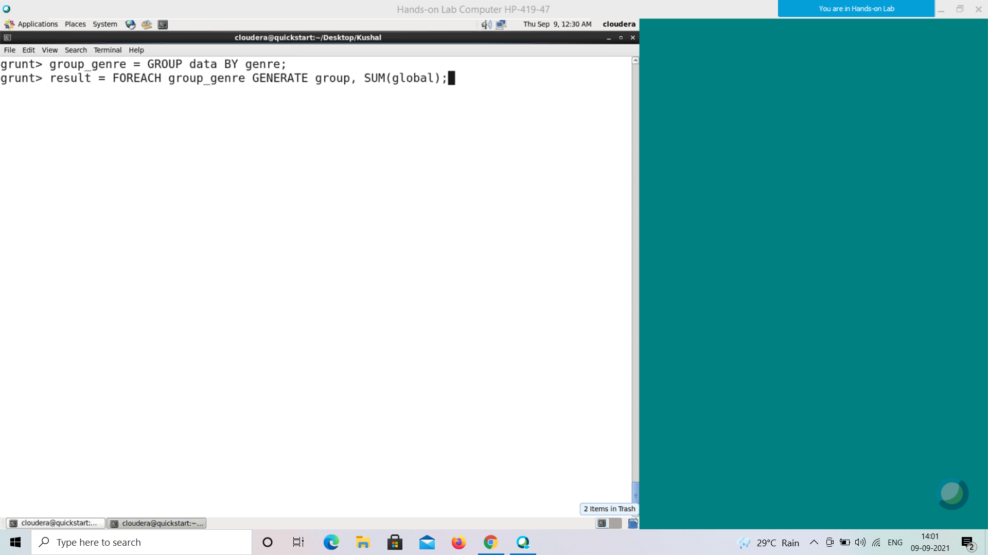
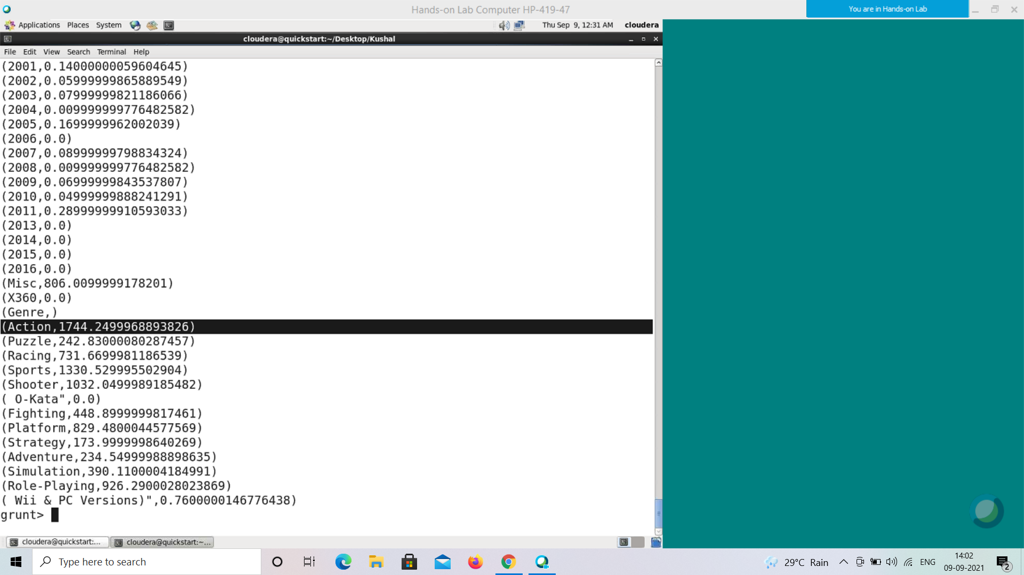

Slide 14
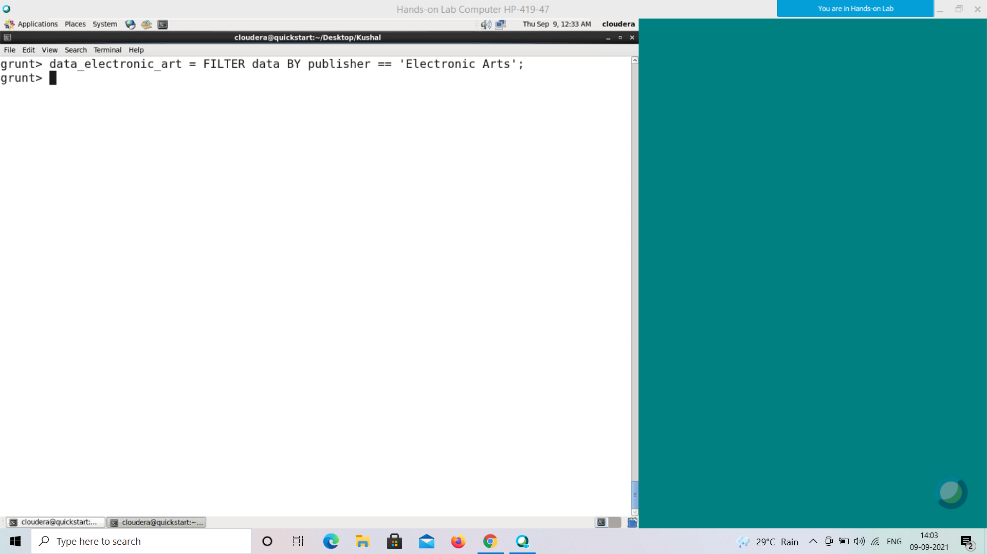
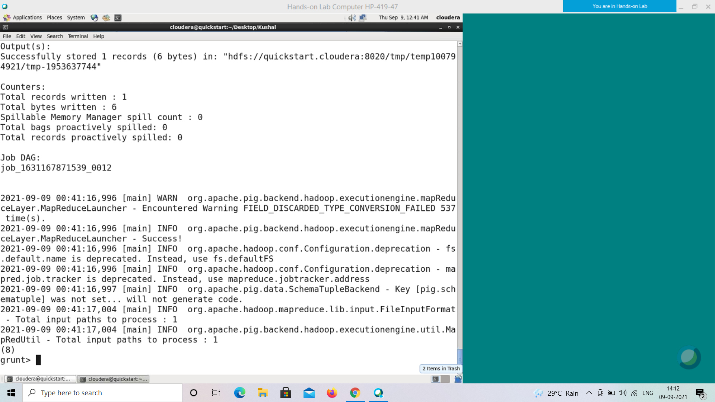

Slide 15
The fields data available
• Rank - Ranking of overall sales
• Name - The games name
• Platform - Platform of the games release (i.e. PC,PS4, etc.)
• Year - Year of the game's release
• Genre - Genre of the game
• Publisher - Publisher of the game
• NA_Sales - Sales in North America (in millions)
• EU_Sales - Sales in Europe (in millions)
• JP_Sales - Sales in Japan (in millions)
• Other_Sales - Sales in the rest of the world (in millions)
• Global_Sales - Total worldwide sales.

Slide 16
Advantages of the tool
Pig is a high level tool which has ability to process large sets of data.
It is Data Flow Language, not declarative unlike SQL, Hence we can easily follow the commands.
Pig is very easy to write as well as read.
It needs less development time.
Pig helps us save memory for storage in our local or data storage.
Pig causes lesser code efficiency as compared to MapReduce.
Pig is also faster.
Instead of verifying one by one data, Pig is allowing us to filter out the expected result by just commands.

Slide 17
Disadvantages of the tool
Not mature: Even if it has been around for quite some time, it is still in the development.
Support: Stackoverflow and Google genrally does not lead good solutions for the problems.
There is not a good idle or plugin for Vim which provides more functionality than syntax completion to write the pig scripts.
The commands are not ececuted unless either we dump or store an intermediate or final result. This increases the iteration between debug and resolving the issue.

Slide 18
Tools & Technology
VMware
Cloudera
Pig
Pig Lagtin Language

Slide 19
Conclusion
Hence, by using the tools like Pig, we are abled to find the tasks that were assigned to us very easily and effectively.
We covered major all the outcomes that were expected.
And we got little bit idea & concepts of vgchartz.com platform as well.

Slide 20



References
google.com
vgchartz.com
wikipedia.org

Slide 21


